Slide 1


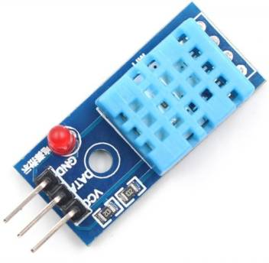
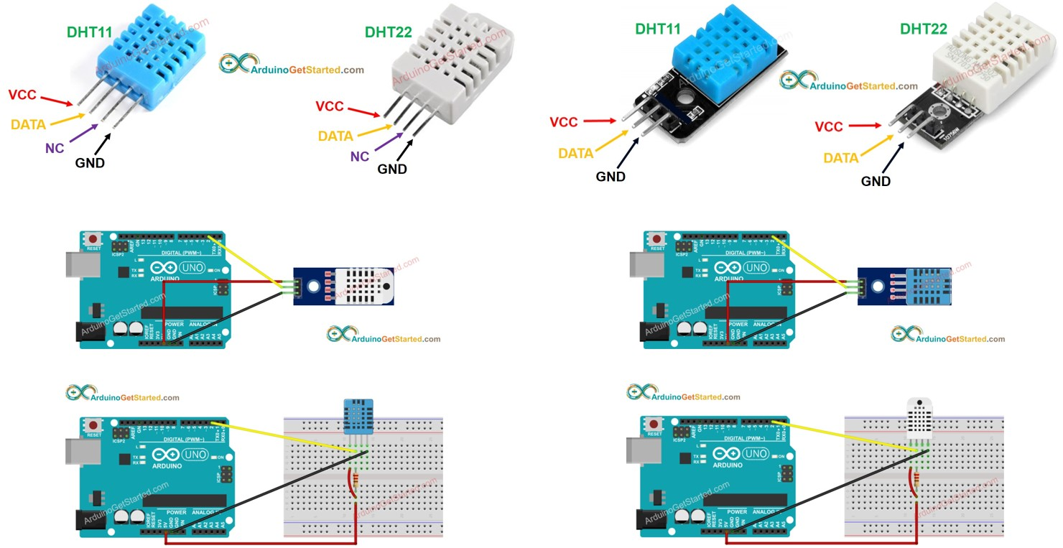
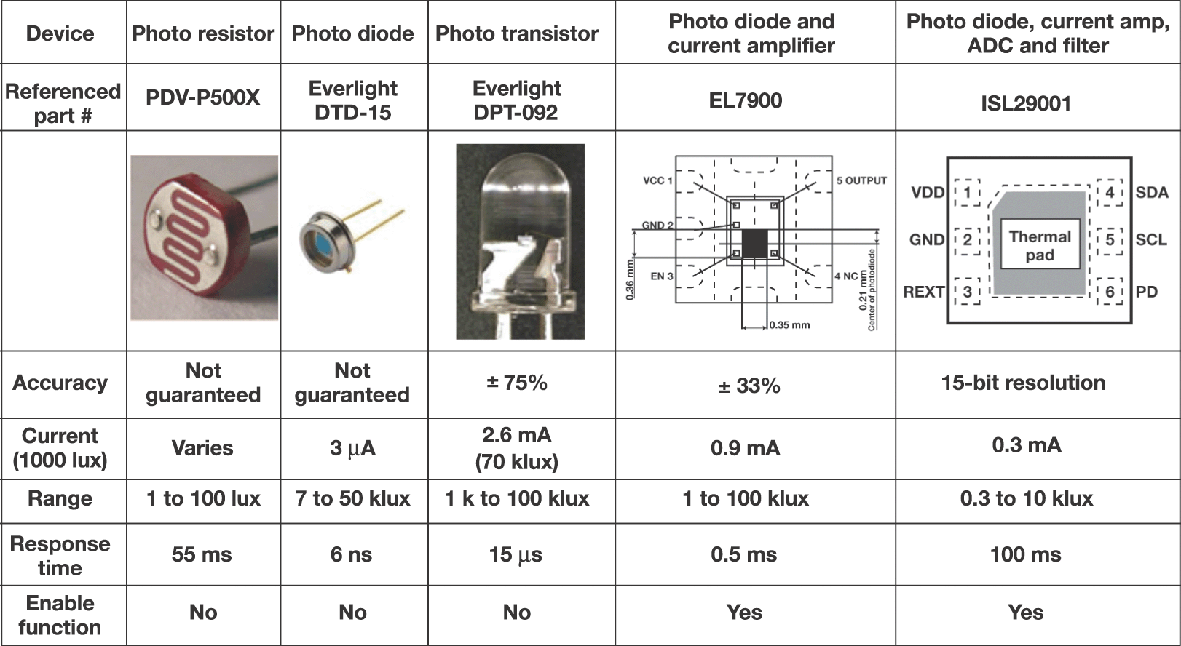
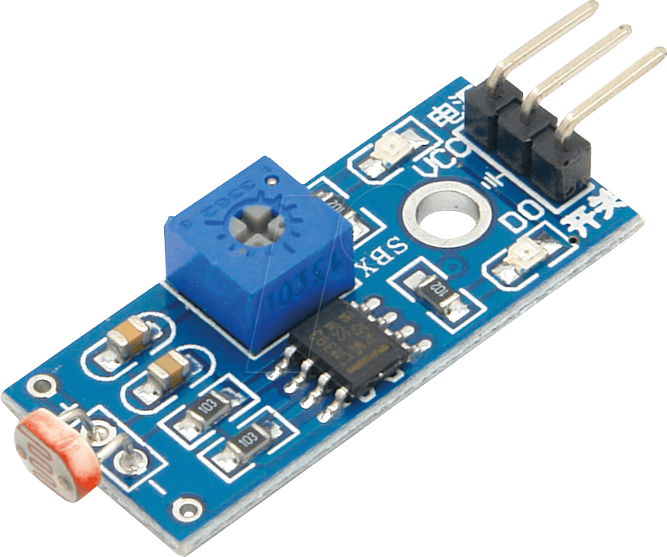
G.H.Raisoni College of Engineering and Management, Pune (An Autonomous Institute Affiliated to Savitribai Phule Pune University)
(1st Year Department)
Sub:-Introduction To Discrete Devices And Circuits.
Humidity, Light Sensors
What is Light Sensor ?
What is Humidity Sensor ?
Light Sensors are photoelectric devices that convert light energy (photons) whether visible or infra-red light into an electrical (electrons) signal.
Humidity is the presence of water in air. The amount of water vapour in air can affect human comfort as well as many manufacturing processes in industries. The presence of water vapour also influences various physical, chemical, and biological processes.
Humidity sensors work by detecting changes that alter electrical currents or temperature in the air. There are three basic types of humidity sensors: capacitive, resistive and thermal. All three types will monitor minute changes in the atmosphere in order to calculate the humidity in the air.
A Light Sensor generates an output signal indicating the intensity of light by measuring the radiant energy that exists in a very narrow range of frequencies basically called “light”, and which ranges in frequency from “Infra-red” to “Visible” up to “Ultraviolet” light spectrum.
Photoelectric devices can be grouped into two main categories, those which generate electricity when illuminated, such as Photo-voltaics or Photo-emissive etc, and those which change their electrical properties in some way such as Photo-resistors or Photo-conductors.
Guided By:-Prof. Prajakta Kanase.
Presented By:-
Sushma D. Yemmewar (C-69)
Swayam P. Terode (C-70)
Tanmay R. Aswale (C-71)
Vallabh R. Shrimangale (C-72)

